Slide 1
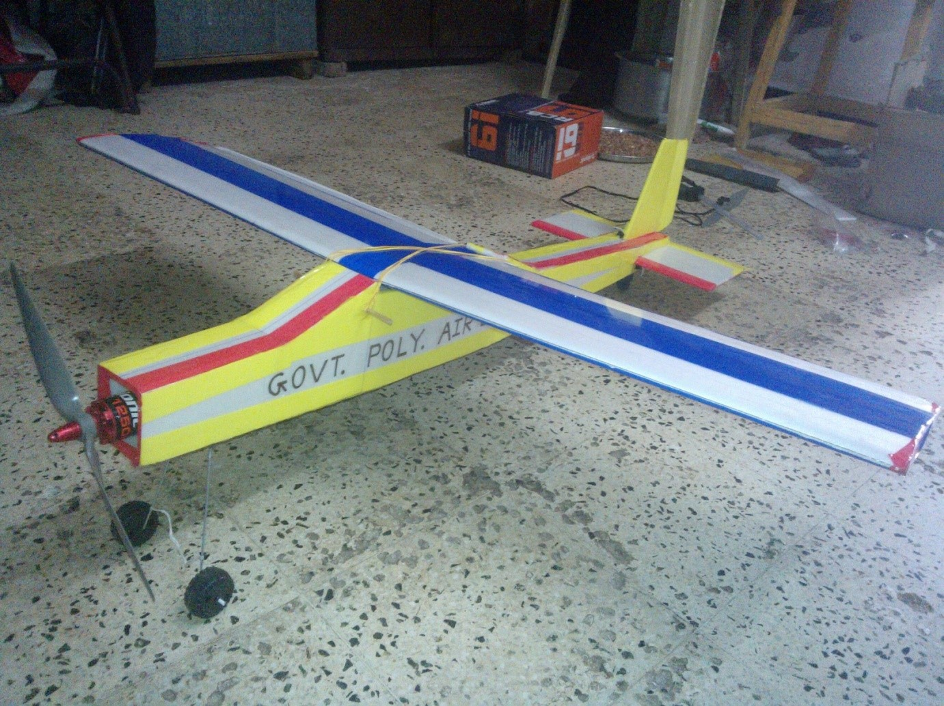
GOVERNMENT POLYTECHNIC RAJKOT
DESIGN OF PROTOTYPE OF AIRCRAFT – ROBOCRAFT
no. | NAME | EnRolment Number
1 | TANK CHIRAG G. | 126200319084
2 | PIPALIYA AJAY V. | 126200319070
3 | JAMBUKIYA JAYDIP M. | 126200319071
4 | VADHER JAYDEEP P. | 126200319098
5 | A.Y. KHAN | 126200319074
6 | AMDAVADI DEVANG K. | 126200319081
GUIDED BY - MR. R. M. VAGHASIYA

Slide 2
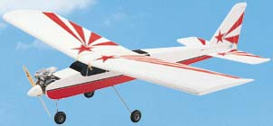
CONCEPT OF RC AIRCRAFT
A radio-controlled (model) A radio-controlled (model) aircraft (often called RC aircraft or RC plane) is a small flying machine that is controlled remotely by an operator on the ground using a hand-held radio transmitter. The transmitter communicates with a receiver within the craft that sends signals to servomechanisms (servos) which move the control surfaces based on the position of joysticks on the transmitter. (often called RC aircraft or RC plane) is a small flying machine that is controlled remotely by an operator on the ground using A radio-controlled (model) aircraft (often called RC aircraft or RC plane) is a small flying machine that is controlled remotely by an operator on the ground using a hand-held radio transmitter. The transmitter communicates with a receiver within the craft that sends signals to servomechanisms (servos) which move the control surfaces based on the position of joysticks on the transmitter.

Slide 3
LIST OF AIRCRAFT PARTS
Body
Radio control
Servo motor
Brushless DC motor
Prop / propeller
Electronic Speed controller
Battery

Slide 4
LIST OF MANUFACTURING PROCESSES
MANUFACTURING OF WING
MANUFACTURING OF FUSELAGE
MANUFACTURING OF STABILIZER
MANUFACTURING OF FIN
MANUFACTURING OF LANDING GEAR
ASSEMBLY OF AIRCRAFT

Slide 5
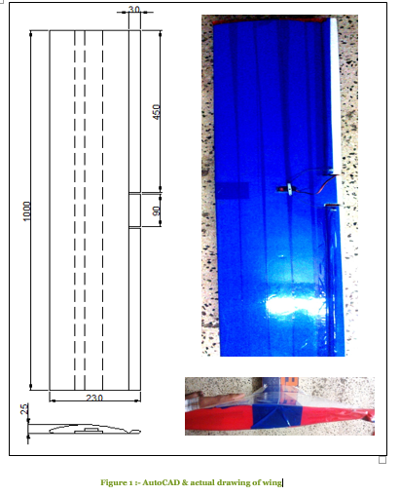
MANUFACTURING OF WING

Slide 6
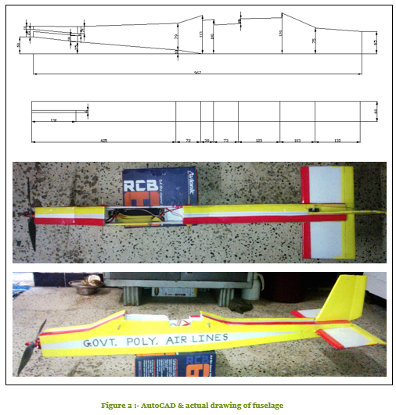
MANUFACTURING OF FUSELAGE

Slide 7
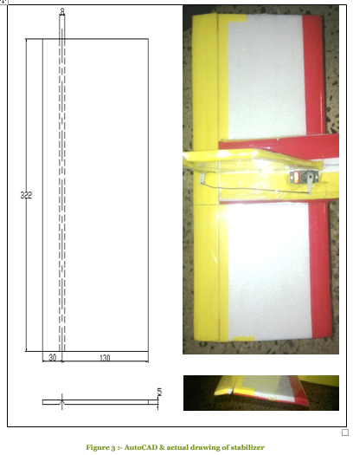
MANUFACTURING OF STABILIZER

Slide 8
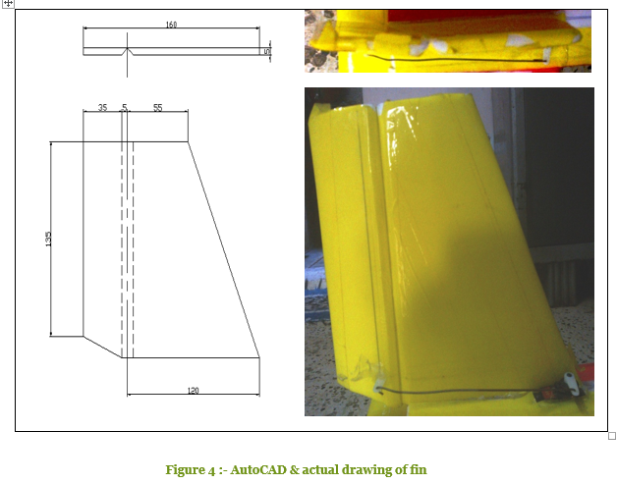
MANUFACTURING OF FIN

Slide 9
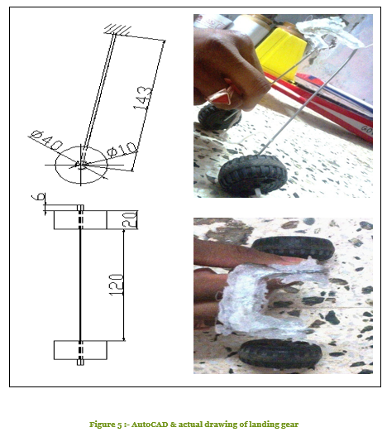
MANUFACTURING OF LANDING GEAR

Slide 10
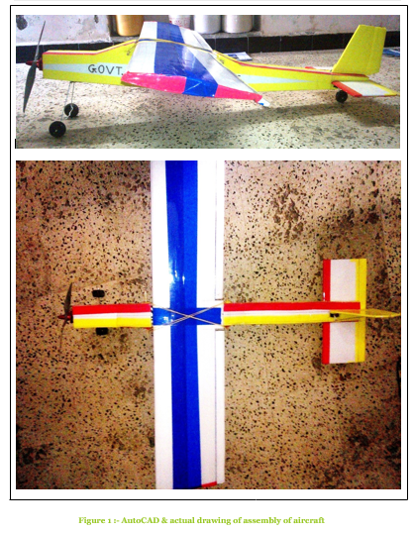
ASSEMBLY OF AIRCRAFT

Slide 11
INNOVATION IN ROBOCRAFT PROJECT
Change in Servo motor
We change in the quantity of the servo motor. Trainer model consist of 4 servo motor at rudder, elevator, right aileron and left aileron. In our project instead of 4 servo motor we used just 3 servo motor at rudder, elevator and one aileron at center of wing. We eliminate 1 servo motor from the wing and other one attached at the vertical center of the wing.
Advantages of innovation
1. Assembly is easy and consists less time due to reduction in quantity of servo motor.
2. Weight of aircraft will be decrease due to reduction in quantity of servo.
3. Aircraft lift capacity will be increase due to reduction in aircraft weight.
4. Easy to handle remote control because extra joystick control is eliminated,
5. The cost of the aircraft will reduce due to consumption in servo motor.

Slide 12
ADVANTAGE OF ROBOCRAFT PROJECT
1. It has most important advantage that it is one type of silent aircraft so it avoids the noise pollution.
2. It is small in the size so it is easy to handle.
3. No necessary for large storage space when not in use.
4. It is the also best toy for the children , by flying the aircraft children learn more controlling of aircraft.
5. It is consists the BLDC motor instead of gasoline or jet engine so it reflect slowly compare to 3d aerobics aircraft thus it is easy to handle.

Slide 13
APPLICATION OF ROBOCRAFT PROJECT
The UAV with its silent operation can protect VIP’s from assassination by performing aerial observation, buried object detection, facial recognition, and laser targeting of hostile personnel. The system uses less-than lethal force or remote CS/CN tear gas deployment, and is also invaluable for counter-sniper detection and neutralization. Generally for Aerial photography the Octocopter is generally more stable. Radio-controlled aircraft are also used for military purposes, with their primary task being intelligence-gathering reconnaissance. An Unmanned Aerial Vehicle (UAV), also known as a drone, is usually not designed to contain a human pilot. Remotely controlled target drone aircraft were used to train gun crews.
New UAV drones are capable of making deliveries, washing windows of tall buildings from the outside, putting out fires, spraying, searching and rescuing people and animals not only in nature, but also in buildings, where drones are becoming an important tool for police and other security agencies. In addition, drones are becoming so large and strong with so much lifting power, they are also now being used to lift people and save them from burning buildings or sinking boats.

